Slide 1
Ethical Hacking
Mohona Ghosh

Slide 2

Logic Bomb
One of the oldest types of program threat, predating viruses and worms, is the logic bomb
The logic bomb is code embedded in some legitimate program that is set to "explode" when certain conditions are met
Conditions that can be used as triggers for a logic bomb are the presence or absence of certain files, a particular day of the week or date, or a particular user running the application. Once triggered, a bomb may alter or delete data or entire files, cause a machine halt, or do some other damage
Logic bombs are most commonly installed by insiders with access to the system who know what security controls need to be circumvented in order to go undetected until they detonate. The malicious code could also be included within an existing piece of software installed on a target system.

Slide 3
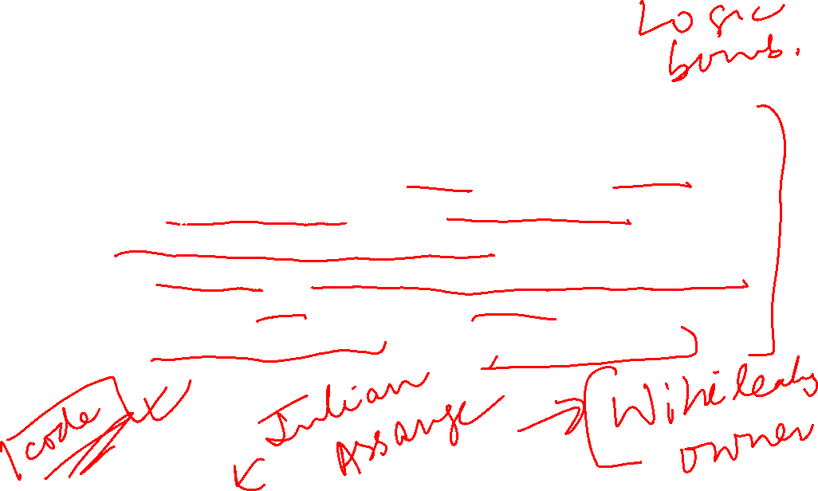
Logic Bomb Example
For example, let's say a privileged user has a grudge against her company and is afraid she might soon be fired. In advance of her firing, she sets up a scheduled job that checks to see if her user account has been active during the past 90 days; if no activity is found, the scheduled job deletes a critical database (salary database). Sure enough, the user is fired, and a few months later, once her account has been inactive for 90 days, the database is deleted

Slide 4

Logic Bomb Example
Julian Assange of Wikileaks
The reason he has not been imprisoned yet is because he has set up a logic bomb in the Wikileaks system that will release all of the information in every channel to the public if Assange does not enter a specific code into the system daily

Slide 5

Rootkits
A rootkit is malware that is extremely hard to detect and that actively tries to hide itself from the user, the OS and any anti-virus/anti-malware programs.
The software can get installed in any number of ways including exploiting a vulnerability in the OS or by gaining administrator access to the computer.
After the program has been installed and as long as it has full administrator privileges, the program will then go about hiding itself and altering the currently installed OS and software to prevent detection in the future.
Rootkits will turn off system’s anti-virus or install into the OS kernel, whereby the only option left sometimes is to reinstall the entire operating system
They are the most dangerous malware and most difficult to detect

Slide 6
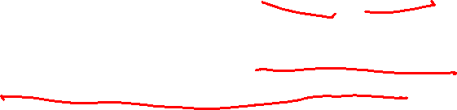

Rootkits
The term rootkit is a connection of the two words "root" and "kit“
Originally, a rootkit was a collection of tools that enabled administrator-level access to a computer or network. Root refers to the Admin account on Unix and Linux systems, and kit refers to the software components that implement the tool
Today rootkits are generally associated with malware – such as Trojans, worms, viruses – that conceal their existence and actions from users and other system processes.
The primary purpose of a rootkit is to allow an attacker repeated unregulated and undetected access to a compromised system. Installing a backdoor process or replacing one or more of the files that run the normal connection processes can help meet this objective.

Slide 7
Rootkits

Slide 8

Types of Rootkits
Hardware or firmware rootkit - The name of this type of rootkit comes from where it is installed on your computer. This type of malware could infect your computer’s hard drive or its system BIOS, the software that is installed on a small memory chip in your computer’s motherboard. The rootkit hides in firmware because firmware is not usually inspected for code integrity. It can even infect your router. Hackers can use these rootkits to intercept data written on the disk.
Bootloader rootkit - Computer’s bootloader is an important tool. It loads the computer’s operating system when you turn the machine on. Boot-loader-level (bootkit) rootkits function either by replacing or modifying the legitimate boot loader with another one. This means that this rootkit is activated even before your computer’s operating system turns on. So, boot-loader-level (bootkit) rootkits are serious threats to security because they can be used to hack encryption keys and passwords.

Slide 9


Types of Rootkits
Kernel level Rootkit- The kernel is a computer program at the core of a computer's operating system with complete control over everything in the system. It is an integral part of any operating system. It is the portion of the operating system code that is always resident in memory. It facilitates interactions between hardware and software components. On most systems, it is one of the first programs loaded on startup (after the bootloader). It handles the rest of startup as well as input/output requests from software, translating them into data-processing instructions for the central processing unit. It handles memory and peripherals like keyboards, monitors, printers, and speakers.
Kernel-mode rootkits run with the highest operating system privileges by adding code or replacing portions of the core operating system, including both the kernel and associated device drivers. Most operating systems support kernel-mode device drivers, which execute with the same privileges as the operating system itself. As such, many kernel-mode rootkits are developed as device drivers or loadable modules, such as loadable kernel modules in Linux or device drivers in Microsoft Windows. This class of rootkit has unrestricted security access, but is more difficult to write. If the kit's code contains mistakes or bugs, the stability of the system is greatly affected by the kernel-level rootkits. These have the same privileges of the operating system, hence they are difficult to detect and intercept or subvert operations of operating systems.

Slide 10


Types of Rootkits
Memory rootkit - This type of rootkit hides in your computer’s RAM, or Random Access Memory. These rootkits will carry out harmful activities in the background. However they suffer from the limitation that these rootkits have a short lifespan. They only live in your computer’s RAM and will disappear once you reboot your system.
Application rootkit - Application rootkits replace standard files in your computer with rootkit files. They might also change the way standard applications work. These rootkits might infect programs such as Word, Paint, or Notepad. Every time you run these programs, you will give hackers access to your computer. The challenge here is that the infected programs will still run normally, making it difficult for users to detect the rootkit.

Slide 11

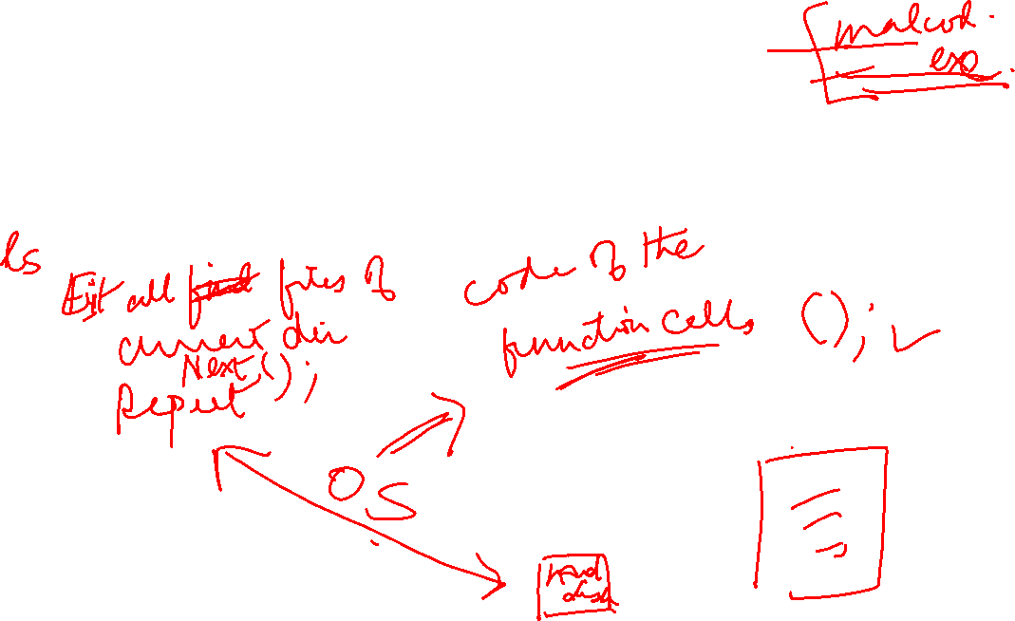
Rootkits Example
https://www.youtube.com/watch?v=yUiL_ejOCiE

Slide 12
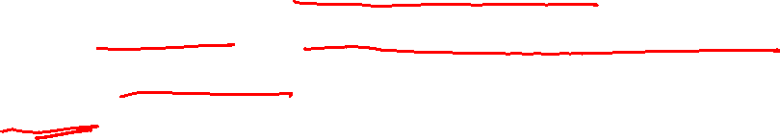
How Rootkits Work ?
Rootkits may use a variety of techniques to gain control of the operating system and hide from both the user and security software.
Different techniques may be used in combination to increase overall effectiveness
Let us look at a few …

Slide 13

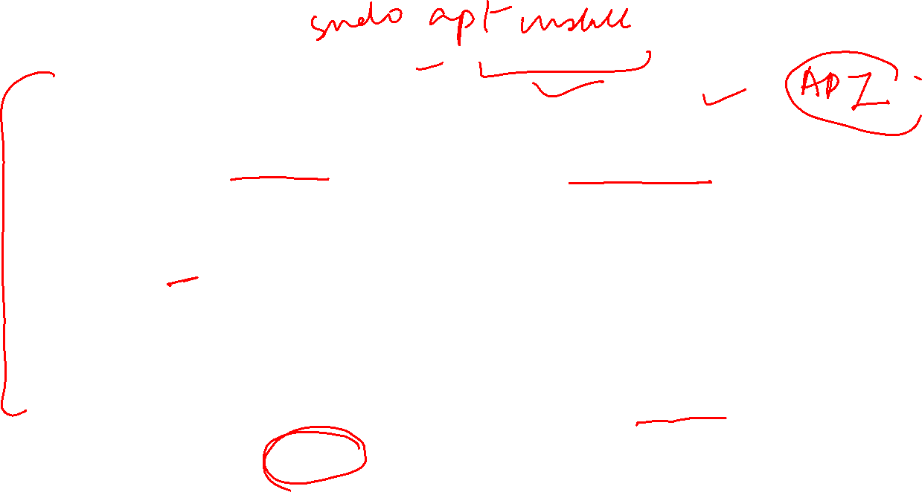
Hooking
Windows has two modes for executing code — user mode and kernel mode.
Of these, the kernel mode is the most important, as it acts as the direct link between the hardware and software code. This is the highest privileged mode, or “root” in a Windows system.
But not all programs and processes require access to the full range of processing power and system hardware. These lower-level functions are handled at a mode with lower privileges — the user mode.
In kernel mode, the OS runs codes directly to execute all the high-level tasks of managing the system. In contrast, user mode uses an Application Programming Interface (API) to indirectly execute codes. During the normal operation of the system, the API performs function calls to the kernel and receives information in return.
A rootkit usually hijacks these function calls, either at the user mode or the kernel mode, depending on its design
This hijacking is called hooking

Slide 14
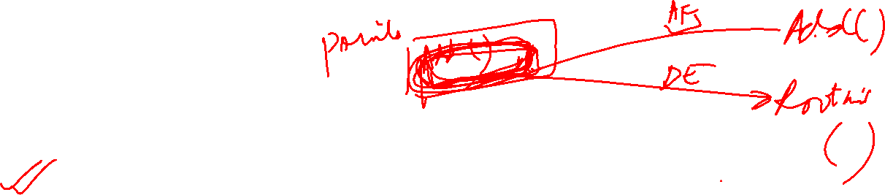
Hooking
System hooking is a process of changing and replacing the original function pointer with the pointer provided by the rootkit in stealth mode.
Let us see how system hooking is done in user mode rootkits using DLL injection ….
In Windows, API hooking is a technique that is commonly employed to modify or change the flow of API calls.
A user mode rootkit exploits this technique to inject malicious code into a program’s memory while remaining concealed.

Slide 15

Hooking
For this to work, the rootkit has to insert its code into a commonly called process.
In Windows, Dynamic Link Libraries (DLLs) are perfect for this, since they are called by many different programs installed in the OS.
Let us briefly understand what are DLLs ….

Slide 16
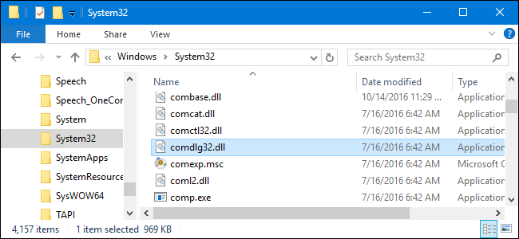

Dynamic Linked Libraries (DLLs)
A dynamic-link library (DLL) is a code that contains functions and data that can be used by another module (application or DLL) or more than one program at the same time.
For example, in Windows operating systems, the Comdlg32 DLL performs common dialog box related functions. Therefore, each program can use the functionality that is contained in this DLL to implement an Open dialog box. This helps promote code reuse and efficient memory usage.
It is a collection of small programs that can be loaded when needed by larger programs and used at the same time.
The small program lets the larger program communicate with a specific device, such as a printer or scanner.
It is often packaged as a DLL program, which is usually referred to as a DLL file. DLL files that support specific device operation are known as device drivers.
A DLL file is often given a ".dll" file name suffix
A DLL can define two kinds of functions: exported and internal.
The exported functions are intended to be called by other modules, as well as from within the DLL where they are defined.

Slide 17

Dynamic Linked Libraries (DLLs)
Internal functions are typically intended to be called only from within the DLL where they are defined.
Although a DLL can export data, its data is generally used only by its functions.
DLL files are dynamically linked with the program that uses them during program execution rather than being compiled into the main program.
The advantage of DLL files is that space is saved in random access memory (RAM) because the files don't get loaded into RAM together with the main program. When a DLL file is needed, it is loaded and run. For example, as long as a user is editing a document in Microsoft Word, the printer DLL file does not need to be loaded into RAM. If the user decides to print the document, the Word application causes the printer DLL file to be loaded and run.
DLLs help operating systems and programs run faster, use memory efficiently and take up less disk space.

Slide 18
Hooking
As discussed earlier, in Windows, Dynamic Link Libraries (DLLs) play a perfect host for rootkits to be injected
DLL injection is the method used by the rootkit user (hacker) to insert malicious code into various programs performing API calls in the operating system.
There are several ways to achieve this:
Modifying the registry values to add a new malicious DLL to the Windows system
Using global hooking in Windows to affect all program API calls
By creating a remote thread for the target process to add infected DLL to it

Slide 19

Hooking
There are two different API hooking techniques often employed
IAT hooking
Inline hooking

Slide 20
IAT Hooking
In Windows, an Import Address Table (IAT) is used to streamline access to DLLs with their variable function addresses. The IAT hosts the function pointers of DLLs as they are loaded by the Windows loader during an API call.
IAT contains pointers to information that is critical for an executable to do its job:
A list of DLLs it depends on for providing the expected functionality
A list of function names and their addresses from those DLLs that may be called by the binary at some point
Using IAT hooking, a rootkit can make changes to the DLL function calls list, replacing existing functions with its own address.
Rootkits achieve this by overwriting the target function's address with a rogue function address in IAT
When an application makes an API call for that function, the rootkit code is loaded instead into the victim program’s memory space.

Slide 21
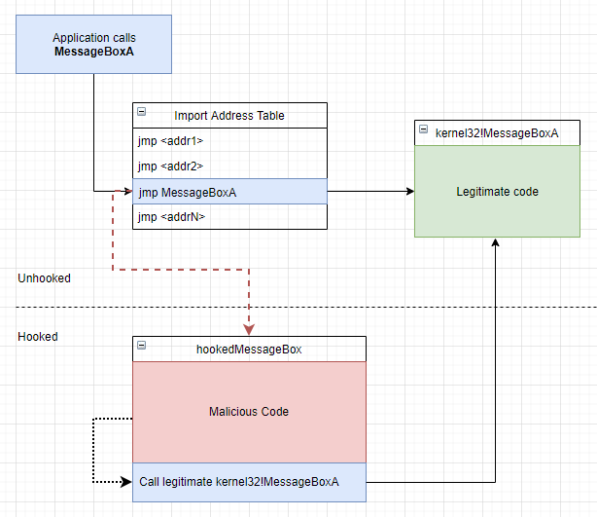
IAT Hooking
Before Hooking
The target program calls a WinAPI MessageBoxA function
The program looks up the MessageBoxA address in the IAT
Code execution jumps to the kernel32!MessageBoxA address resolved in step 2 where legitimate code for displaying the MessageBoxA (green box) lives

Slide 22
IAT Hooking
After Hooking
The target program calls MessageBoxA like before hooking
The program looks up the MessageBoxA address in the IAT
However, this time, because the IAT has been tampered with, the MessageBoxA address in the IAT is pointing to a rogue hookedMessageBox function (red box)

Slide 23
IAT Hooking
After Hooking
The program jumps to the hookedMessageBox retrieved in step 3
HookedMessageBox intercepts the MessageBoxA parameters and executes some malicous code
HookedMessageBox then calls the legitimate kernel32!MessageBoxA routine

Slide 24

Inline Hooking
Inline hooking is a method of intercepting calls to target functions, which is mainly used by antiviruses, sandboxes, and malware.
The general idea is to redirect a function to a malware function, so that rootkits can perform processing before and/or after the function does its own.
The hooks are placed by directly modifying code within the target function (inline modification), usually by overwriting the first few bytes with a jump; this allows execution to be redirected before the function does any processing.
Most hooking engines use a 32-bit relative jump (opcode 0xE9 i.e., unconditional jump), which takes upto 5 bytes of space.

Slide 25
Inline Hooking
Inline hooking is a more targeted approach than IAT hooking.
It is generally used by malicious program to hide certain aspects of itself. For example, malware might try and install a hook into Windows API functions, which list files in Windows such as FindFirstFile and FindNextFile. When a particular file used by the malware is found by one of these functions, the malware hook code can change how the function works so that it skips over it to the next file, thus hiding the file from Windows Explorer.

Slide 26
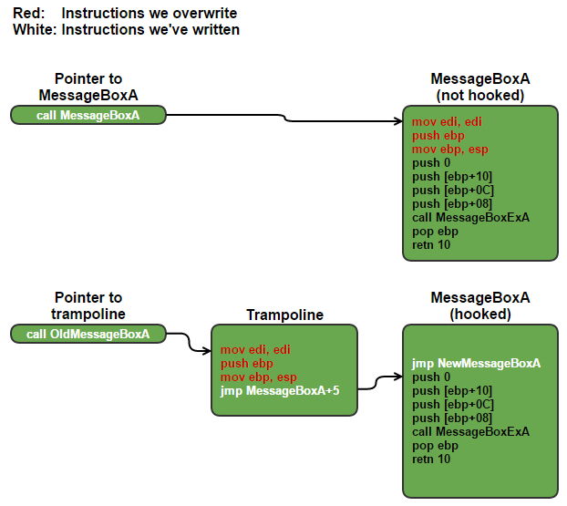
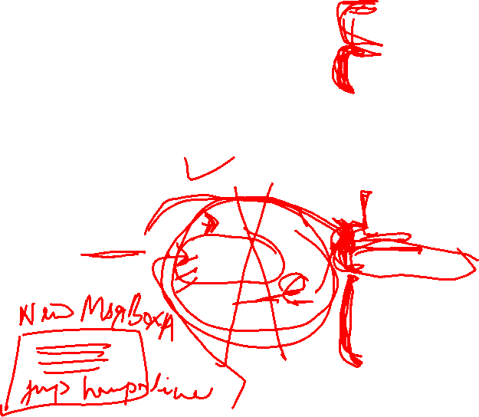
Inline Hooking
Also called trampoline based hook
The hook is made up of 3 parts:
The Hook – A 5 byte relative jump which is written to the target function in order to hook it, the jump will jump from the hooked function to malicious code.
The Proxy – This is malware specified function (or code) which the hook placed on the target function will jump to.
The Trampoline – Used to bypass the hook so we can call a hooked function normally

Slide 27
Inline Hooking
Before Hooking
The target program calls a WinAPI MessageBoxA function
The program looks up the MessageBoxA address in the IAT
Code execution jumps to the address where legitimate code for displaying the MessageBoxA lives and unhooked MessageBoxA function is executed

Slide 28

Inline Hooking
After Hooking
The rootkit overwrites the first 5 bytes of the actual function with its jmp code redirecting the OS to execute code given in NewMessageBox A
To save the original code that was overwritten, the rootkit creates a trampoline storing the actual code parts there

Slide 29

Inline Hooking
After Hooking
If there is a need to call the non hooked MessageBoxA, the rootkits can execute the stored first 5 bytes, followed by a jump 5 bytes into MessageBoxA (directly after the hook) thus hiding its traces

Slide 30
Inline Hooking
A problem rootkit programmer needs to handle is if the first 5 bytes of the function don’t make up n whole instructions).
In the example, the first 5 bytes of the function make up exactly 3 instructions (mov edi, edi; push ebp; mov ebp, esp), however, if for example, the first instruction was 10 bytes long and we only stored 5 bytes: the trampoline would be trying to execute half an instruction and the program would explode.
To get around this, the code uses a disassemble program to get the length of each instruction, so to make sure only to copy whole instructions.
The best case scenario is the first n instructions add up to exactly 5 bytes, the worst case is if the first instruction is 4 bytes and the second is 16 (the maximum length of an x86 instruction), then there is a need to store 20 bytes (4 + 16), meaning the trampoline code must be 25 bytes in size (space for up to 20 bytes worth of instructions and a 5 byte jump back to the hooked function).
It’s important to note that the return jump must jump to the hooked function n bytes in, where n is however many instructions we stored in the trampoline.

Slide 31

MBR function
The MBR or Master Boot Record is the portion of the hard drive that tells the BIOS (Basic Input Output System) where to find the OS (Operating System).
This is a critical handoff of responsibility between the BIOS which does the initial boot sequence when the computer is started and the OS which takes over.
By subverting (attacking it secretly and in an indirect way) this process the rootkit (sometimes called bootkit) is able to inject itself between the computer's hardware and OS, subtly altering data sent back and forth to mask its presence and take over the system.

Slide 32

MBR function
Every time the OS tries to read files from the hard drive, the rootkit intercepts the attempt and substitutes either fake data to hide itself or modified data to trick the OS into loading and executing infected files.
By selectively intercepting attempts to read and execute kernel drivers the rootkit loads itself into memory and takes over the OS. If the user attempts to view the rootkit files, the rootkit can give a false report of there being no trace of its files.
Since the rootkit often never actually modifies the OS files on the hard drive itself, but only gives modified data when the file is being loaded into memory, it becomes even harder to detect. It can also detect and intercept any attempt to delete the rootkit itself or any portion thereof. Even if the rootkit is deleted, since it is loaded in the MBR, the system can be reinfected when it is rebooted.

Slide 33

Slack Space
Every file on a hard drive is allocated a certain amount of space.
Because space is allocated in fixed size "chunks" or disk clusters, most often the file that has been allocated the space doesn't use all of its allocated space and there is a little bit left over. This is known as slack space.
Rootkits have long been known to hide in such areas of the disk, spread out over the slack space allocated to several normal files. Ordinary attempts to read the portions of the disk where rootkit resides will simply show the file to which those disk clusters have been allocated.
It takes specialized tools to read these sections of the disk, and even then it is difficult to tell a rootkit in slack space from the random junk data that would normally be there anyway.
A rootkit taking advantage of this method will most likely store itself in the slack space of protected system files that will not change much or ever, because of the risk of having itself overwritten when the file to which the space is allocated grows in size.
Most AV tools and even AR (anti-rootkit) tools are not able to scan slack space, which makes this an excellent hiding place for malware which will enable it to remain undetected even when the hard drive is examined on a noncompromised system.

Slide 34
Rootkits Example

Slide 35

Detecting Rootkits

Slide 36
Detecting Rootkits

Slide 37

Detecting Rootkits
Cross view based detection techniques are relatively new and show a lot of promise. These techniques assume that the operating system has been subverted, but this method leverages the fact that there is usually more than one way to ask the same question.
In a cross view based detection method, the detection software calls the common APIs to enumerate key elements within the computer system such as the list of files, processes, or Registry keys. However, to be successful, the detection software must also have an algorithm to generate a similar data set that does not rely upon the common APIs.
Any difference in these two data sets reveals something hidden because it did not exist in the data set generated using the common APIs.
Cross view based detection relies upon the fact that API hooking or manipulation of kernel data structures will taint the data returned by the operating system APIs, but the low level methods used to glean the same information will be designed in such a manner as not to be subverted by hooks

Slide 38
How to defend against Rootkits?

Slide 39
How to defend against Rootkits?

